Slide 1
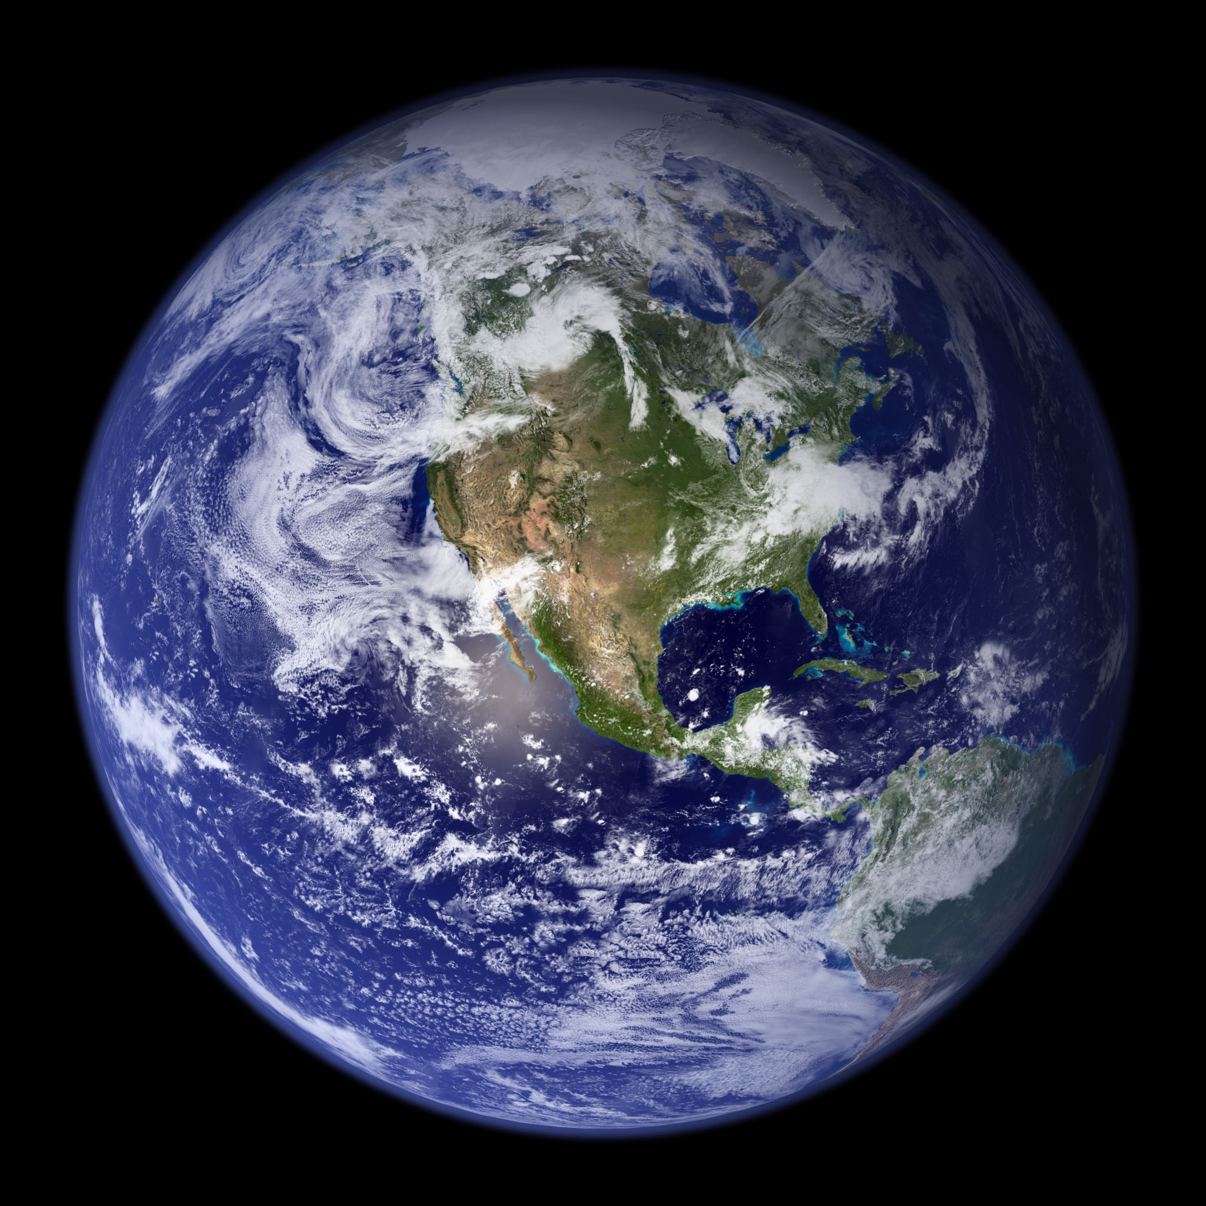

Week 8
Cryosphere
Climate Modeling
282548
Notes:
4:01 long

Slide 2
Week 8
Cryosphere
Climate Modeling
Notes:
4:01 long

Slide 3


Slide 4
Required Videos:
The Cryosphere: Rise and Fall of Ice on Earth
Snowball Earth
Arctic Climate Change
Climate Models and Climate Modeling
BYOE Video 1: Introduction
BYOE Video 2: Walkthrough 1
BYOE Video 3: Walkthrough 2
BYOE Video 4: Earth’s Past Climates
Required Reading:
Geological Society of London Scientific Statement: What the geological record tells us about our present and future climate
Hoffman and Schrag (2000): Snowball Earth

Slide 5
For Week 8
Questions from last week or videos
Cryosphere throughout geological history
Climate modeling
Build Your Own Earth exercise
Kahoot!

Slide 6
Cryosphere

Slide 7
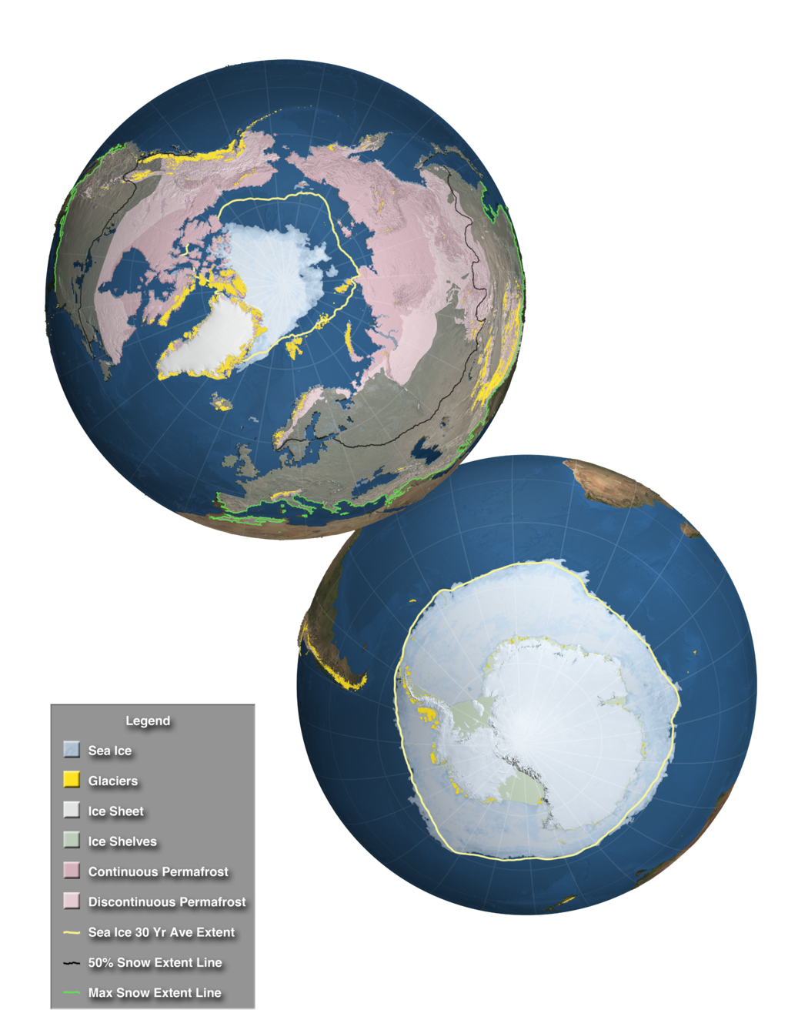
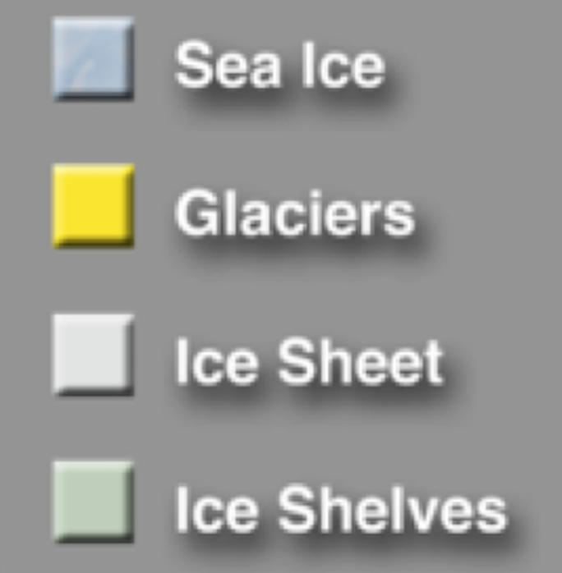
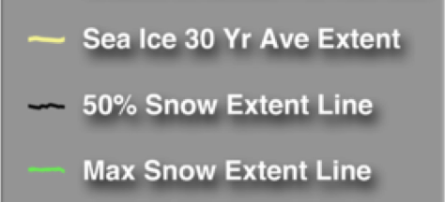
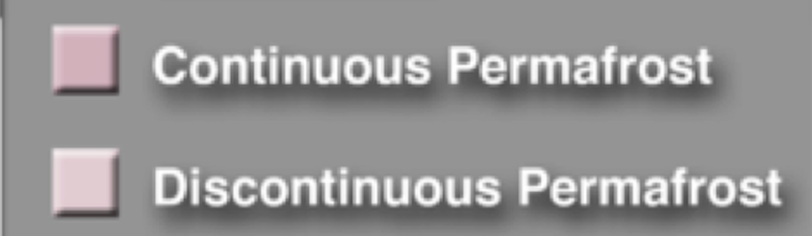
IPCC/NASA

Slide 8
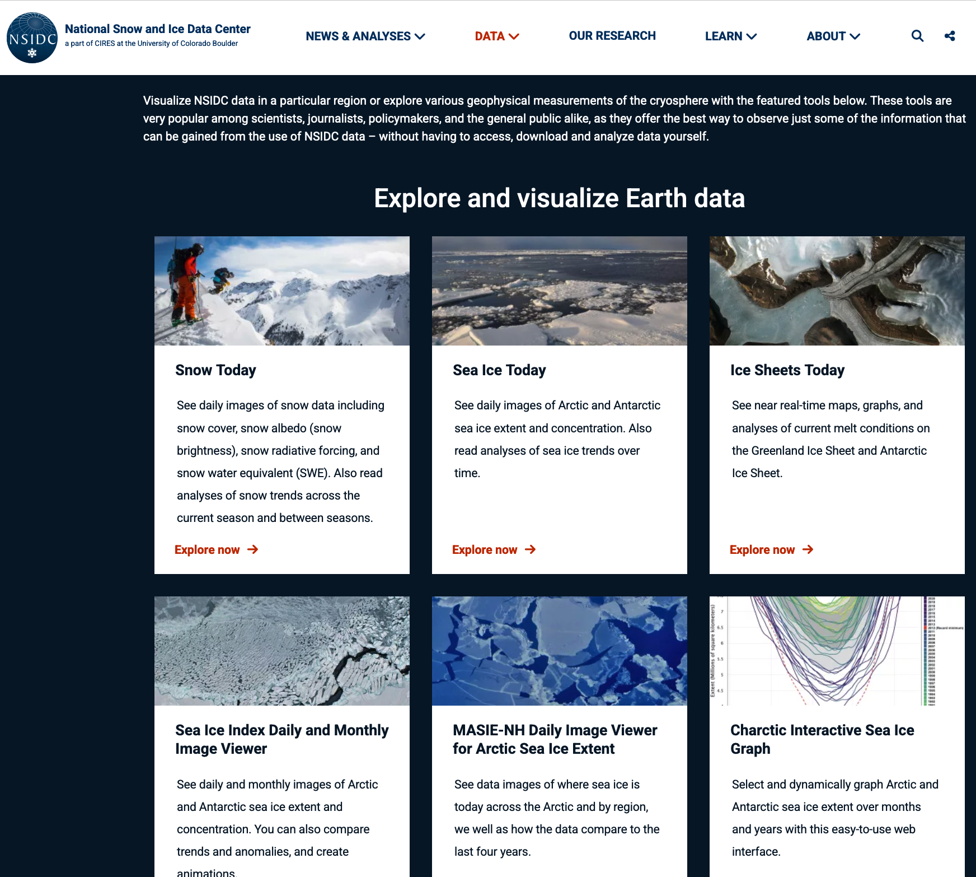
https://nsidc.org/data/visualize-data

Slide 9
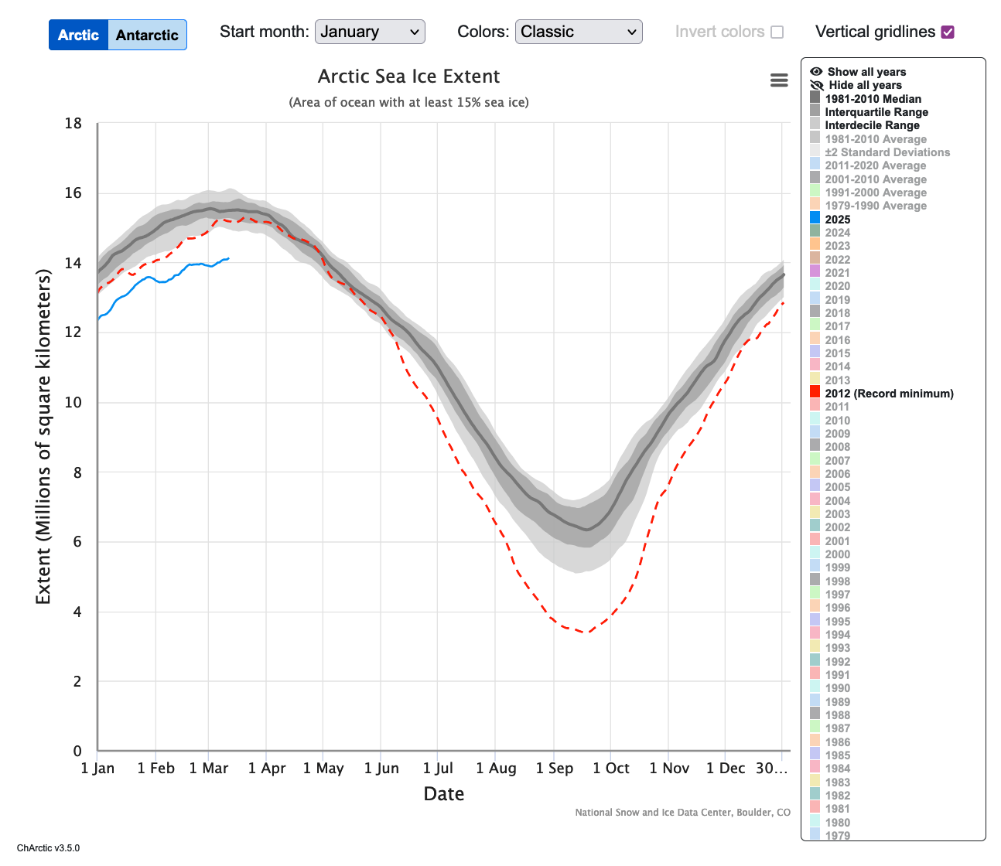
https://nsidc.org/sea-ice-today/sea-ice-tools/charctic-interactive-sea-ice-graph
Notes:
https://nsidc.org/sea-ice-today/sea-ice-tools/charctic-interactive-sea-ice-graph

Slide 10
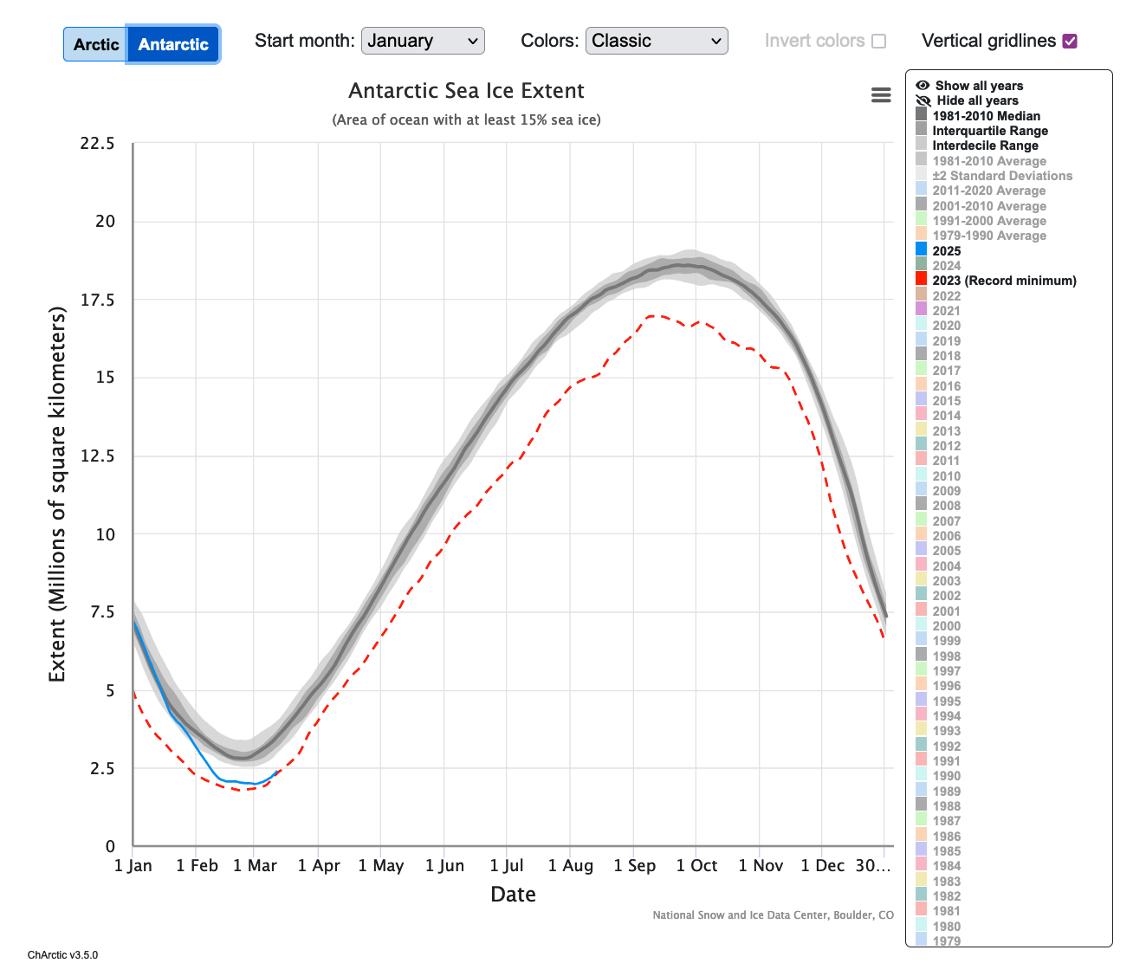
https://nsidc.org/sea-ice-today/sea-ice-tools/charctic-interactive-sea-ice-graph
Notes:
https://nsidc.org/sea-ice-today/sea-ice-tools/charctic-interactive-sea-ice-graph

Slide 11
Climate Modeling

Slide 12
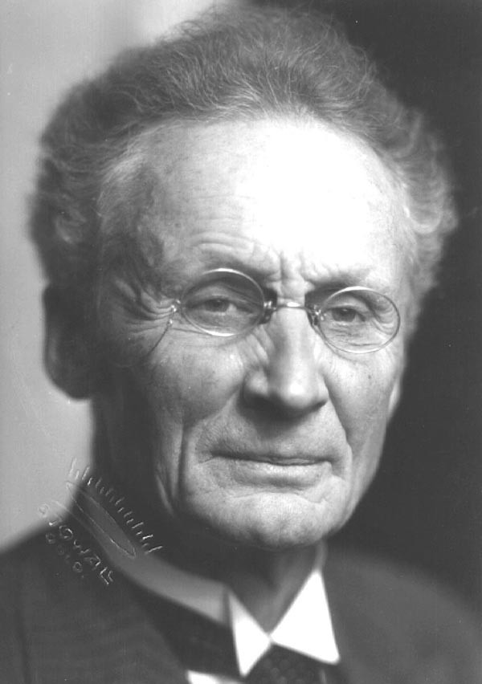
How to make a weather forecast:
  1. A sufficiently accurate knowledge of the state of the atmosphere at the initial time
  2. A sufficiently accurate knowledge of the laws according to which one state of the atmosphere develops from another.
Vilhelm Bjerknes (1904)

Slide 13
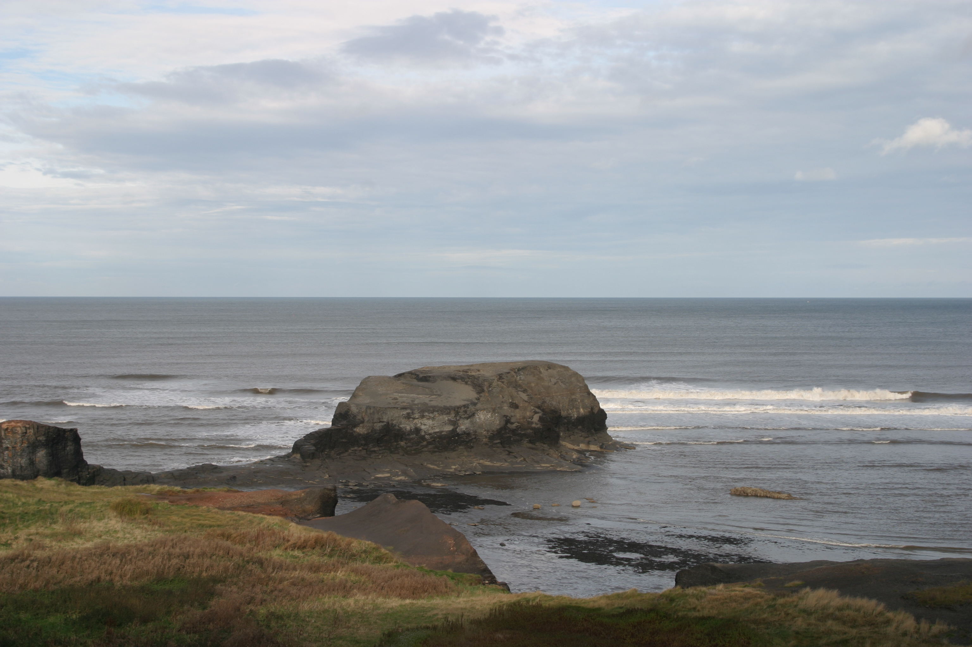
atmosphere
physics
chemistry
hydrosphere
cryosphere→
lithosphere
biosphere
biology

Slide 14
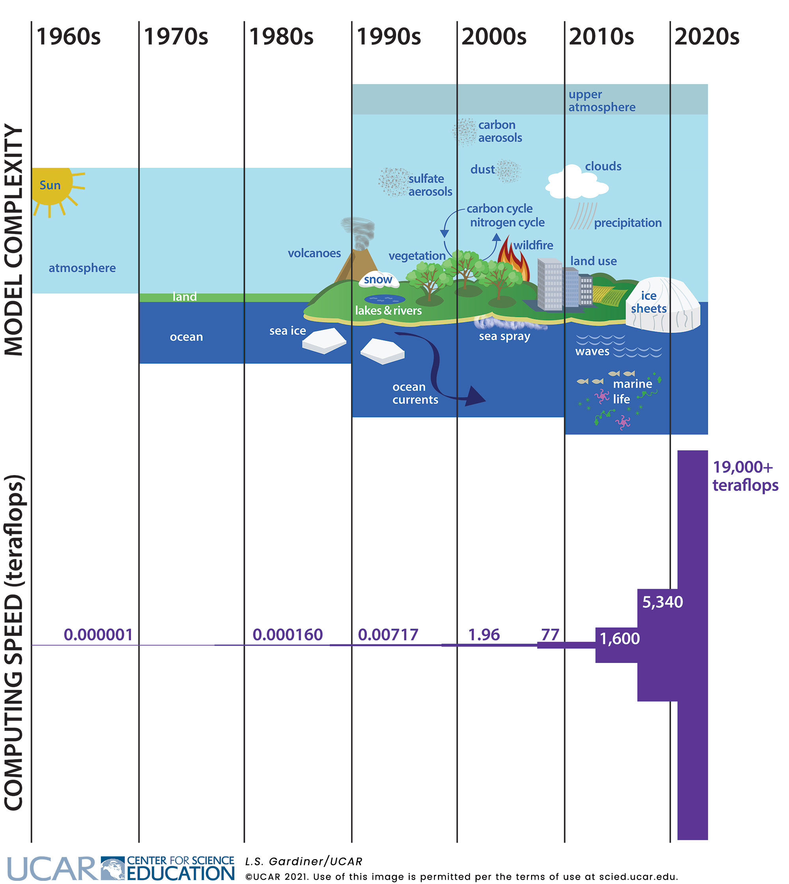
One teraflop is a trillion calculations per second
(“flop” means “floating-point operation”).
Notes:
https://scied.ucar.edu/learning-zone/how-climate-works/fast-computers-complex-climate-models

Slide 15
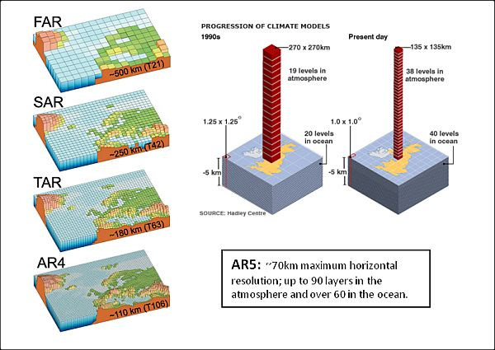
1990
1995
2001
2007
2014, 2022
Notes:
Typical grid spacing for GCMs: 125-300 km (CMIP5); 80-300 (CMIP6)

Slide 16
Simulations in BYOE are computed from several models coupled into one.
Fast Ocean–Atmosphere Model (FOAM) 1.5
Atmospheric dynamics model
CAM2
Ocean dynamics
model
POP3
Coupler
Sea ice
CISM2

Slide 17
How to make a weather forecast:
  1. A sufficiently accurate knowledge of the state of the atmosphere at the initial time
  2. A sufficiently accurate knowledge of the laws according to which one state of the atmosphere develops from another.
some
of the
inputs
outputs
Vilhelm Bjerknes (1904)

Slide 18
what the required inputs are
what the simulated outputs are
Will depend upon the type of climate model

Slide 19
For FOAM:
what the required inputs are
- initial conditions (e.g., atmos/ocean conditions at t = 0)
- boundary conditions (e.g., fixed land-surface conditions, geography)
- external forcings (e.g., incoming solar radiation or solar constant)
- settings in model not predicted (e.g., greenhouse gases)
what the simulated outputs are
- atmos/ocean dynamic quantities (e.g., wind, currents,
temperature, pressure, humidity, snow)
- sea-ice distribution and thickness

Slide 20
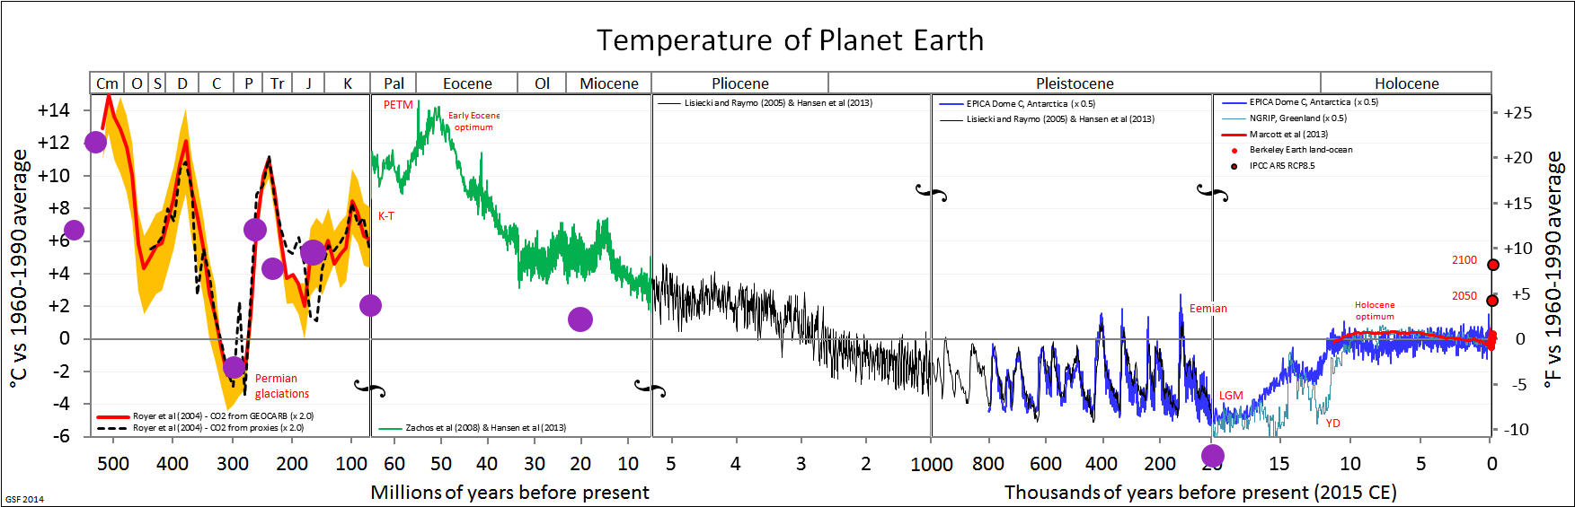
How well does BYOE do?
Purple dots are mean global surface temperature for BYOE simulations

Slide 21
How can climate modeling be used for research?

Slide 22
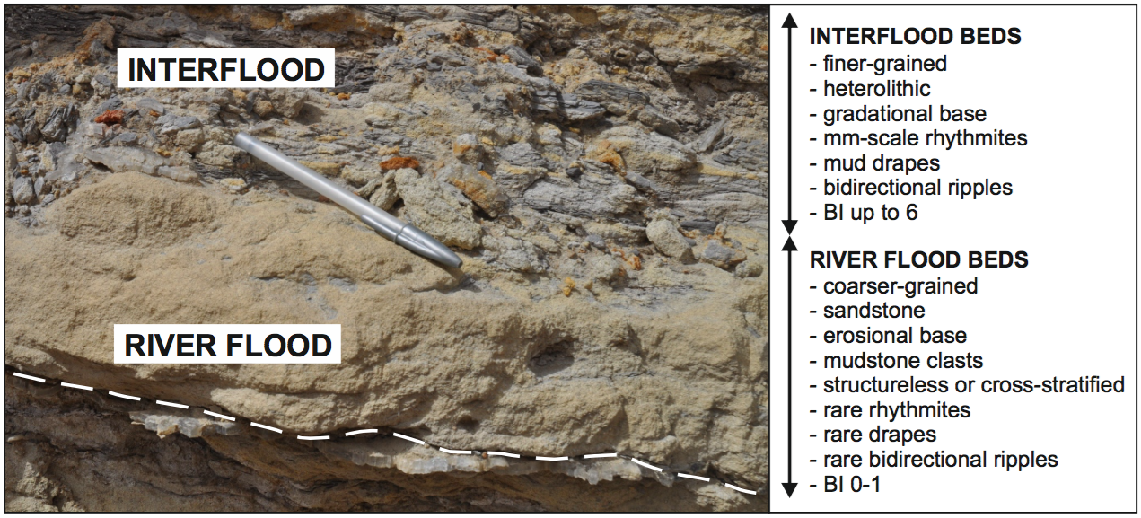
Example 1: Interbedded sediments

Slide 23
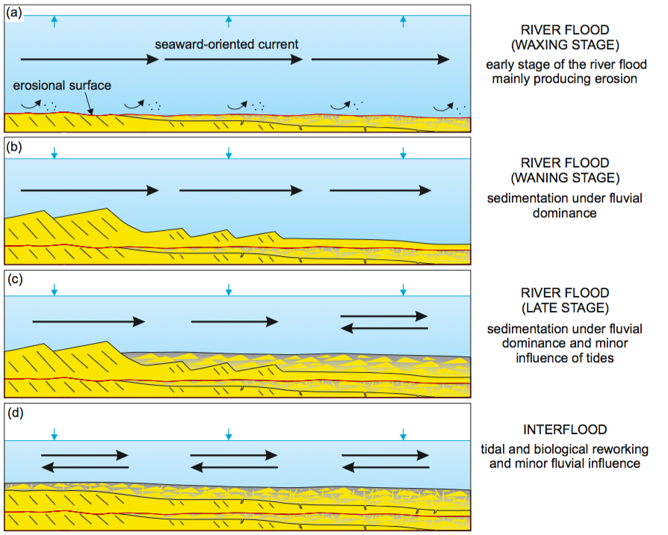
Marcello Gugliotta and Stephen Flint

Slide 24
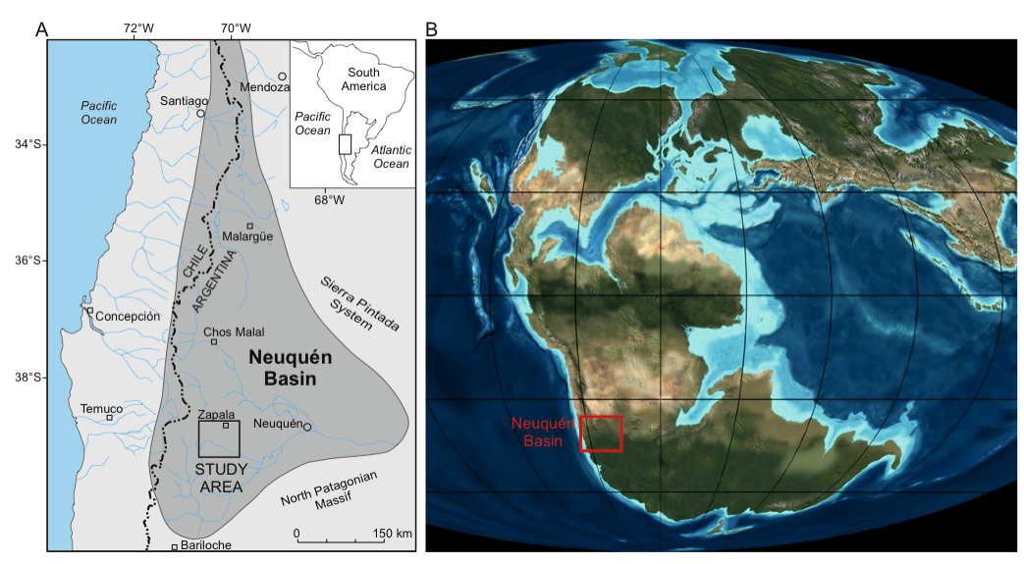
170 Ma – Middle Jurassic
Marcello Gugliotta and Stephen Flint

Slide 25
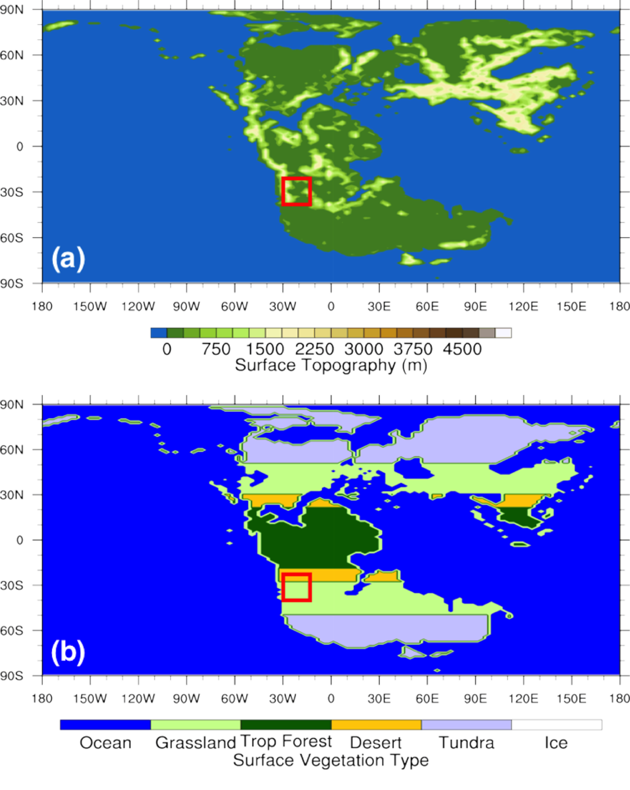

Slide 26
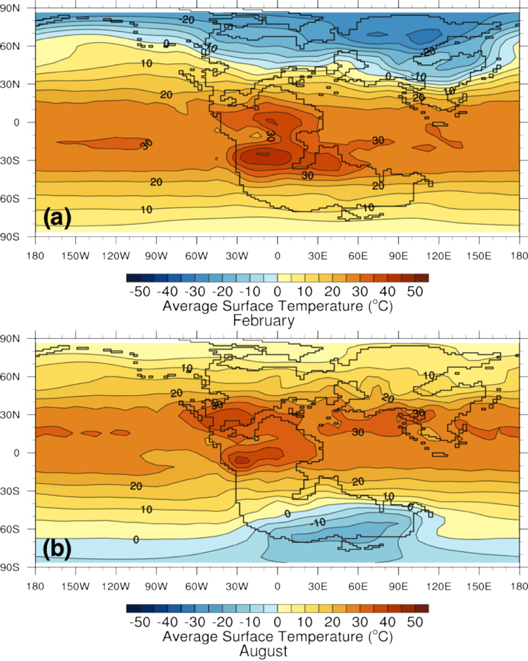
Feb
Aug

Slide 27
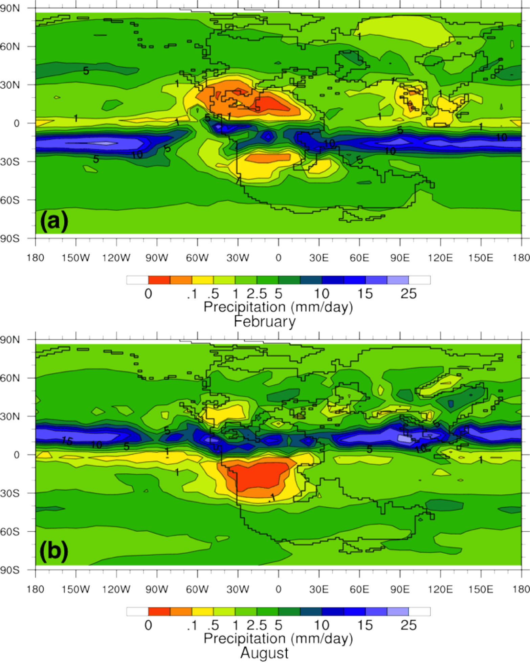
Feb
Aug

Slide 28

Subtropical
deserts
NH winter
Feb
Intertropical
Convergence
Zone
Subtropical
deserts
NH summer
Aug

Slide 29
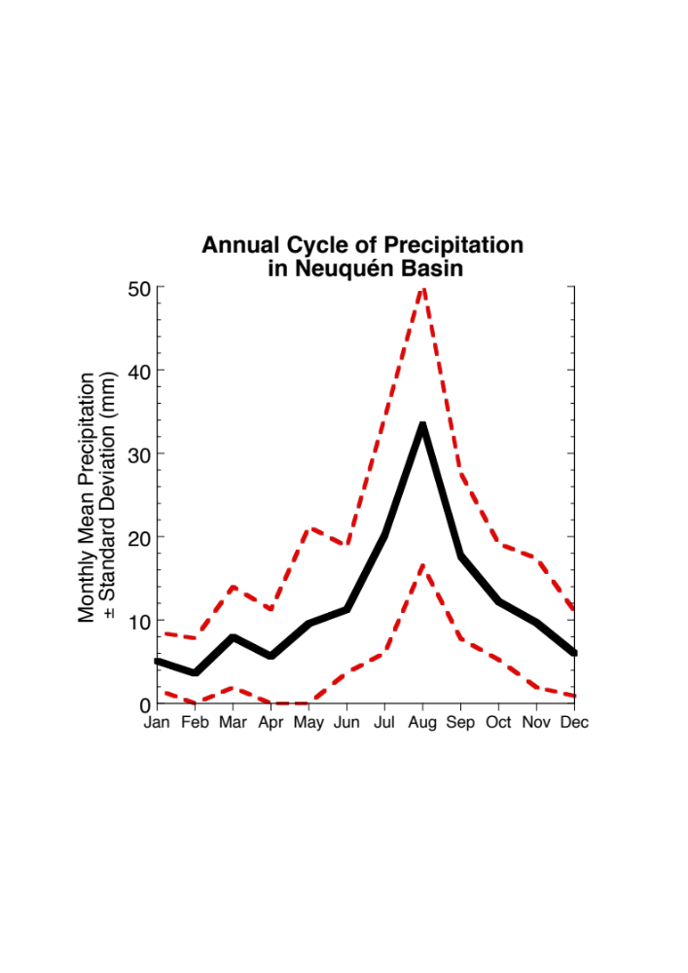

Slide 30
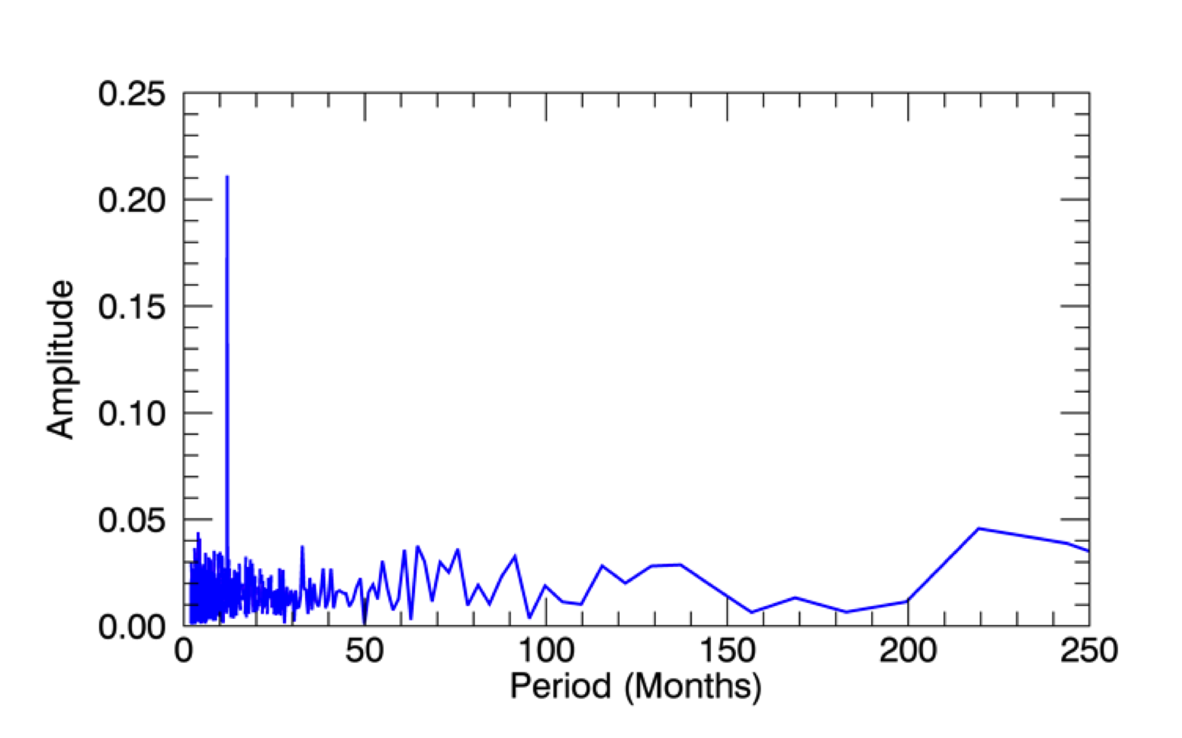
12 months
21% of variance
Fourier analysis breaks down the power in the periods from the time series of the
daily precipitation over the basin.

Slide 31
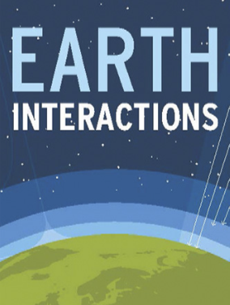

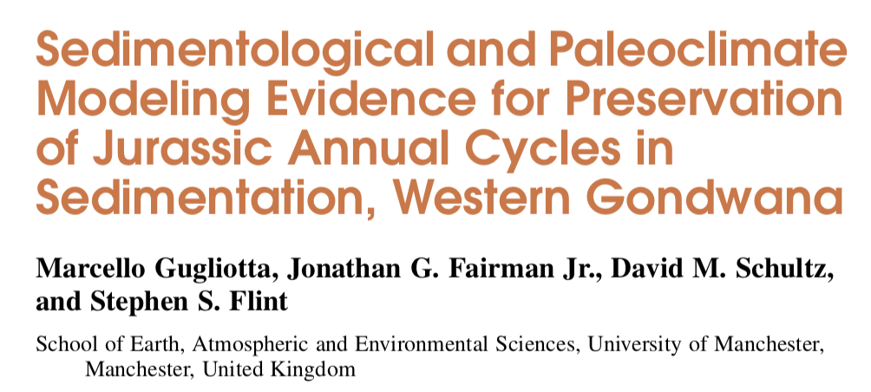

Slide 32

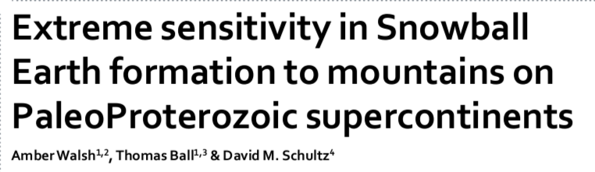
Example 2: Snowball Earth at 2.4 Ga

Slide 33
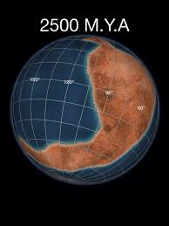
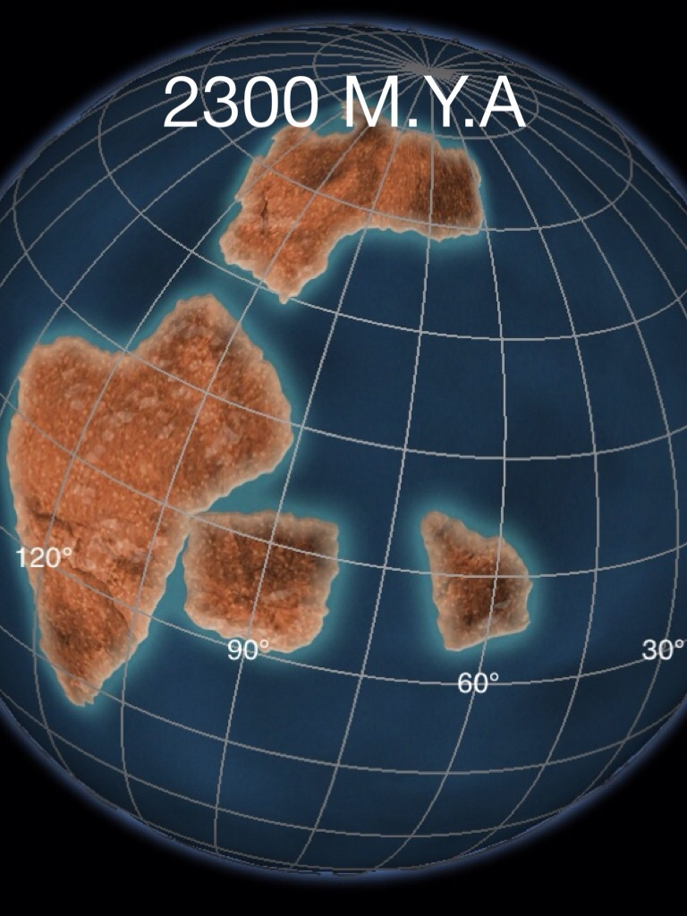
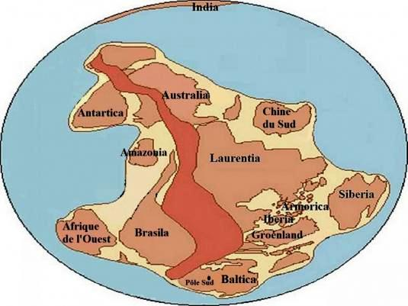
Kenorland (2.7–2.4 Ga)

Slide 34
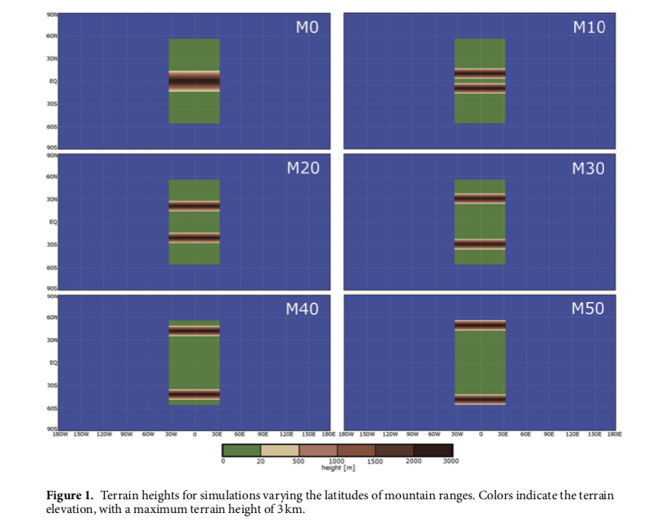
Notes:
For simplicity, our simulations share the same orbital characteristics (i.e., orbital rotation rate, eccentricity, obliquity, date of perihelion) as the present day, with the exception of a 360-day year. The solar constant is set to the predicted solar luminosity 2.4 billion years ago of 1100 W m−2, 19% lower than the present-day value8.
To compensate for this lower solar constant, the concentration of greenhouse gases in the atmosphere was higher than the present-day values10. Greenhouse gases including carbon dioxide and methane have been hypoth- esised to have created a strong greenhouse effect on early Earth. This experiment assumes that carbon diox- ide is the largest contributor to this warming. One possible range of carbon dioxide concentrations during the Proterozoic is 4000 to 80,000 ppmv38. A value of 10,000 ppmv is chosen, a number within this range and also used in another study17. The range of atmospheric methane concentration to test over was decided based on estimates10 and the results of modelling17. This range is 1–100 ppmv.

Slide 35
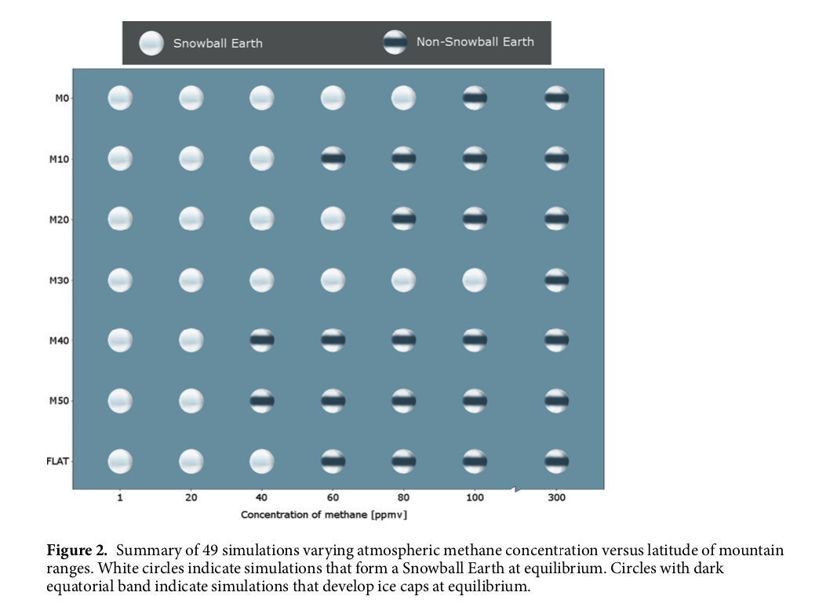
M0
Snowball Earth
can occur at
higher methane
concentrations
due to latitudes
of mountains.
M10
M20
M30
M40
M50
FLAT
methane concentration (ppmv)

Slide 37
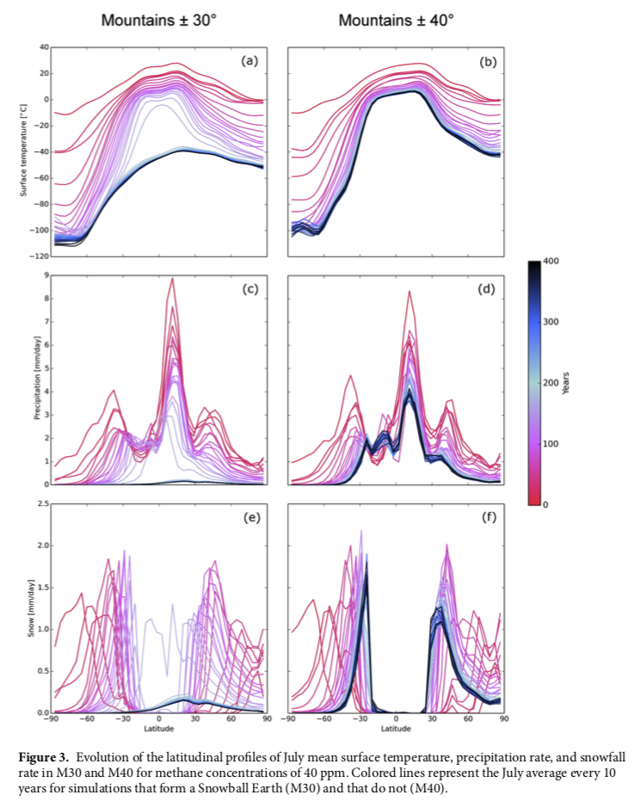
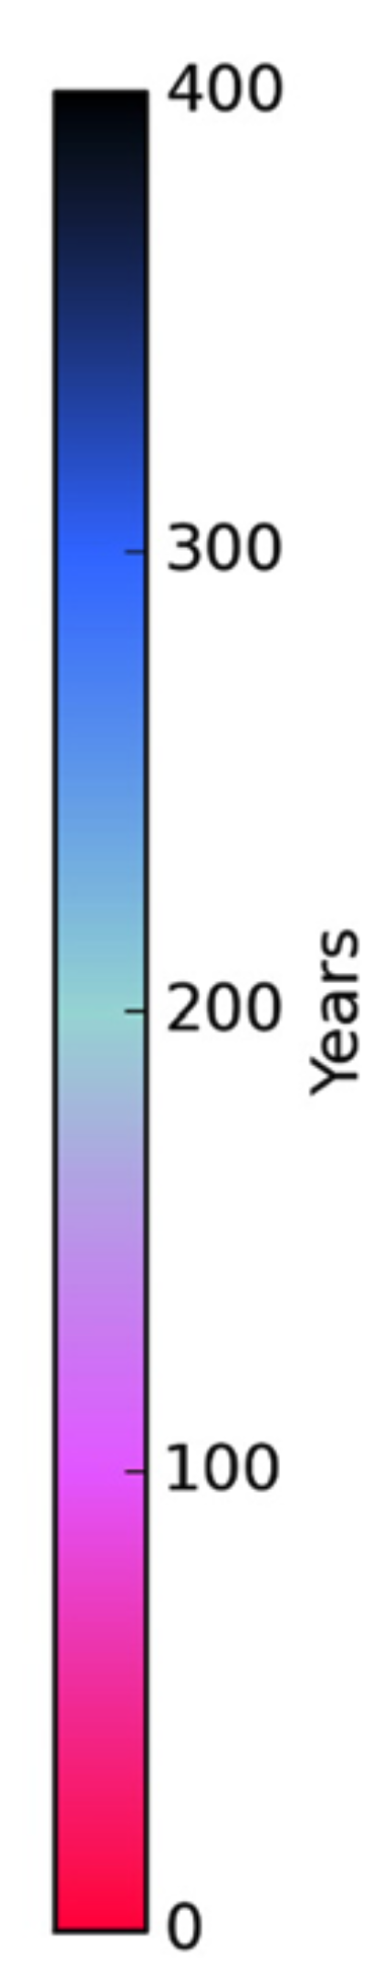


Even in these very coarse simulations, collapse to Snowball Earth happens quickly (within decades).
T_{s}
precip
snow
Each line represents the July average every 10 years into the simulation.

Slide 38
Notes:
For simplicity, our simulations share the same orbital characteristics (i.e., orbital rotation rate, eccentricity, obliquity, date of perihelion) as the present day, with the exception of a 360-day year. The solar constant is set to the predicted solar luminosity 2.4 billion years ago of 1100 W m−2, 19% lower than the present-day value8.
To compensate for this lower solar constant, the concentration of greenhouse gases in the atmosphere was higher than the present-day values10. Greenhouse gases including carbon dioxide and methane have been hypoth- esised to have created a strong greenhouse effect on early Earth. This experiment assumes that carbon diox- ide is the largest contributor to this warming. One possible range of carbon dioxide concentrations during the Proterozoic is 4000 to 80,000 ppmv38. A value of 10,000 ppmv is chosen, a number within this range and also used in another study17. The range of atmospheric methane concentration to test over was decided based on estimates10 and the results of modelling17. This range is 1–100 ppmv.

Slide 39
Terrain is flattened and replaced
with the albedo of ice.
Notes:
For simplicity, our simulations share the same orbital characteristics (i.e., orbital rotation rate, eccentricity, obliquity, date of perihelion) as the present day, with the exception of a 360-day year. The solar constant is set to the predicted solar luminosity 2.4 billion years ago of 1100 W m−2, 19% lower than the present-day value8.
To compensate for this lower solar constant, the concentration of greenhouse gases in the atmosphere was higher than the present-day values10. Greenhouse gases including carbon dioxide and methane have been hypoth- esised to have created a strong greenhouse effect on early Earth. This experiment assumes that carbon diox- ide is the largest contributor to this warming. One possible range of carbon dioxide concentrations during the Proterozoic is 4000 to 80,000 ppmv38. A value of 10,000 ppmv is chosen, a number within this range and also used in another study17. The range of atmospheric methane concentration to test over was decided based on estimates10 and the results of modelling17. This range is 1–100 ppmv.

Slide 41


Slide 42
The formation of a Snowball Earth was sensitive to the location of the mountains on Kenorland.
Simulations fixed carbon dioxide, but varied methane and mountain ranges.
Mountains at 30°N/S are most conducive to forming Snowball Earths, even at higher methane concentrations.
Increasing albedo is more conducive than mountains at low latitudes to Snowball Earths.

Slide 43
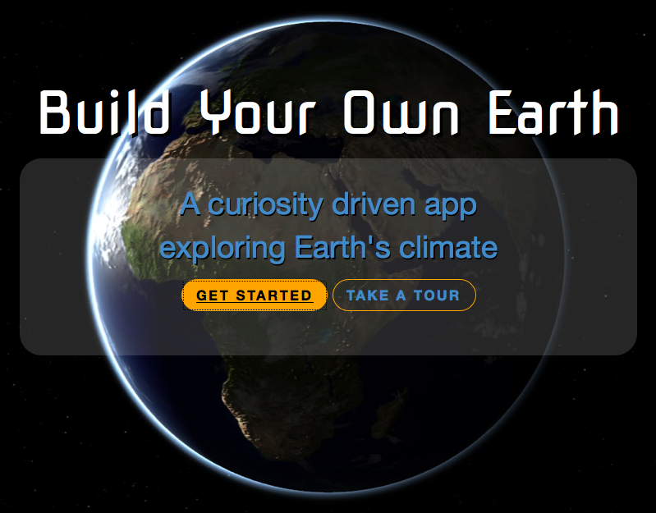
buildyourownearth.com
Built in collaboration with
Stuart Anderson and Sharon Gardner
EPS eLearning Team

Slide 44
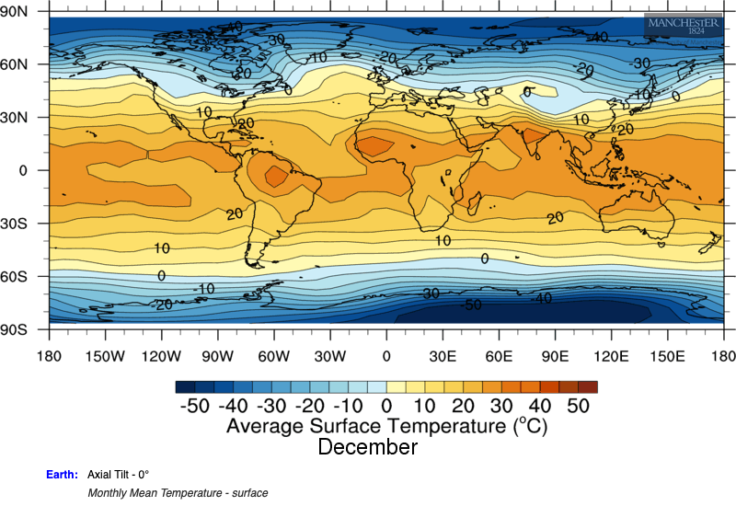
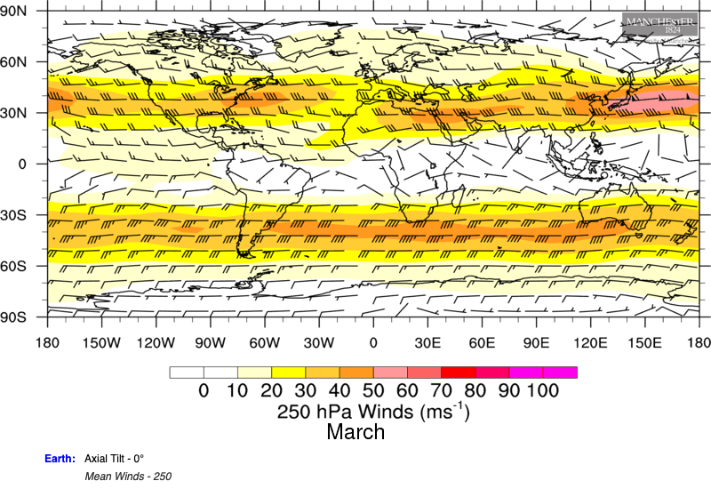
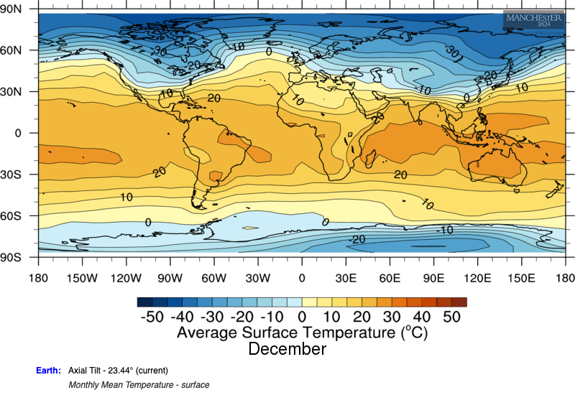
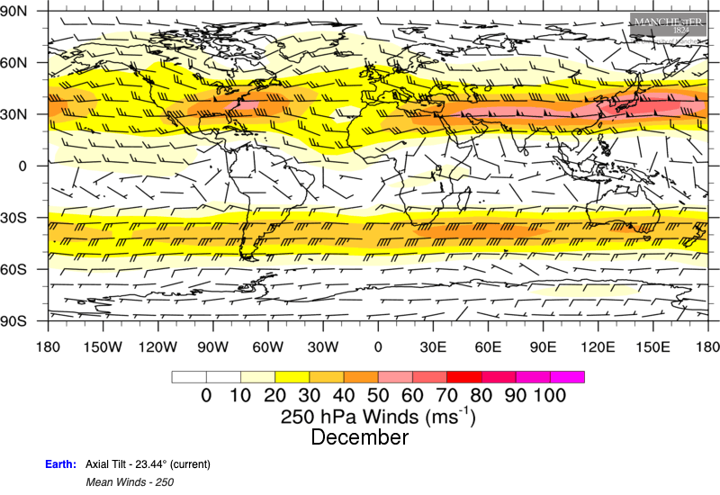
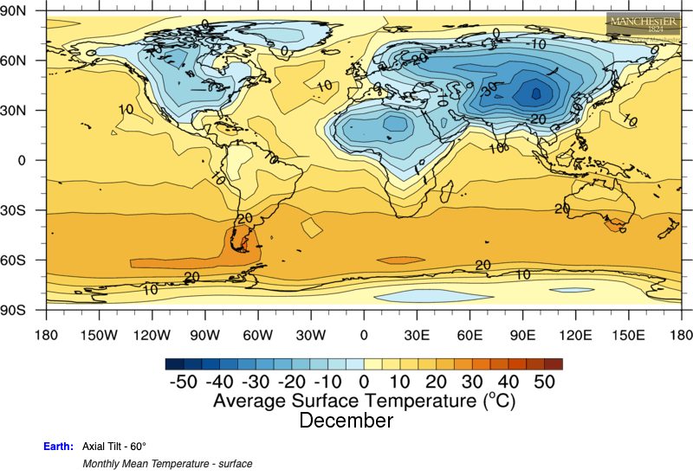
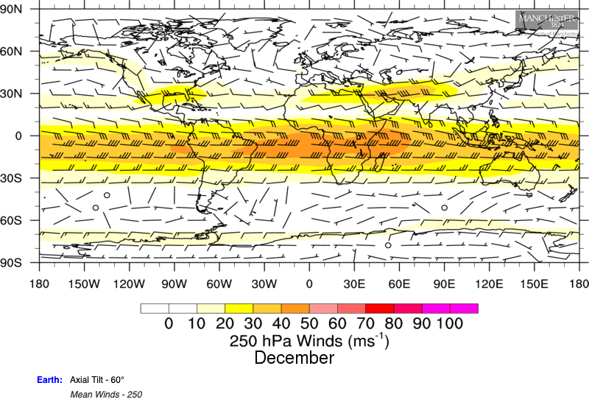
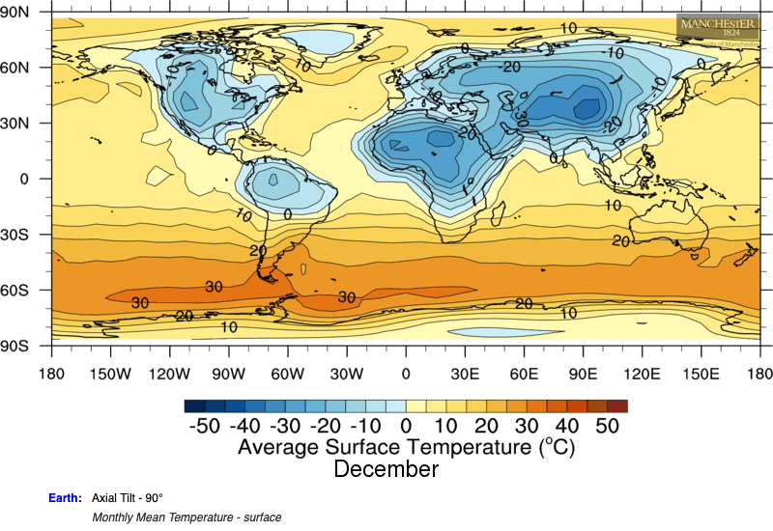
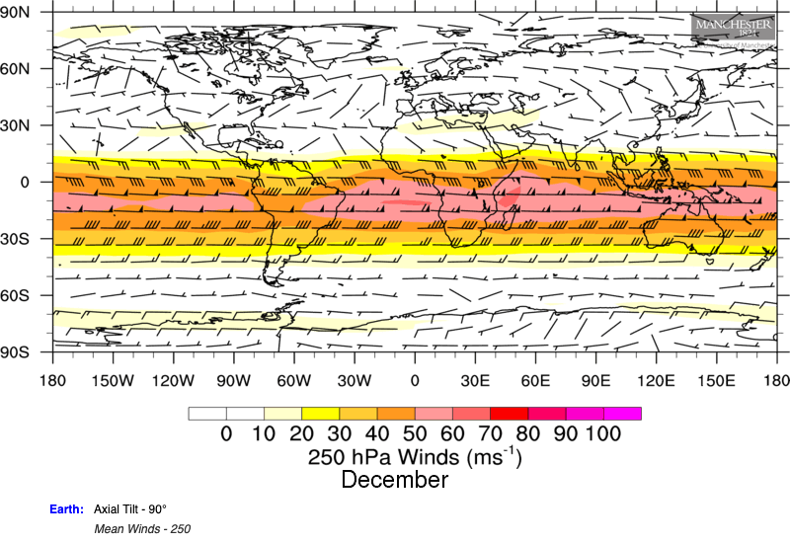
0°
23.44°
60°
90°

Slide 45
0°
23.44°
60°
90°

Slide 46
0°
Highest temperatures follow the Sun.
23.44°
Polar jet streams separate warm
from cold air.
60°
Westerly winds when temperature decreases toward the pole.
Easterly winds when temperature increases toward the pole.
90°

Slide 47
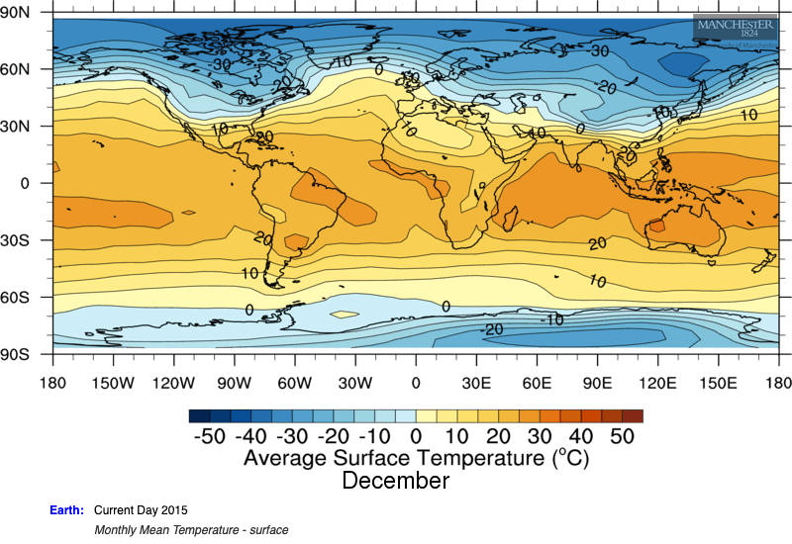
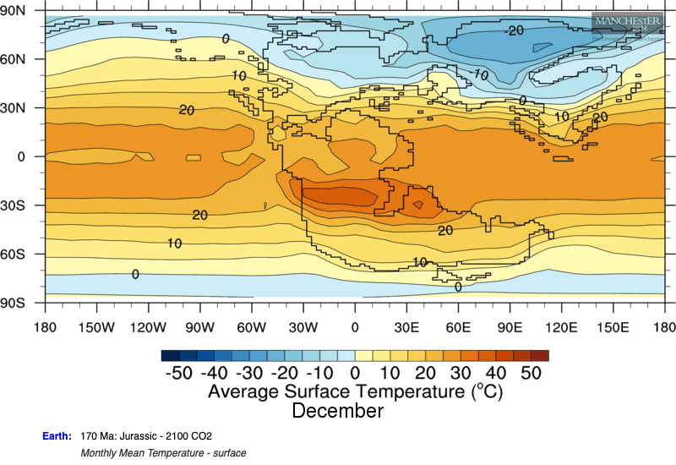
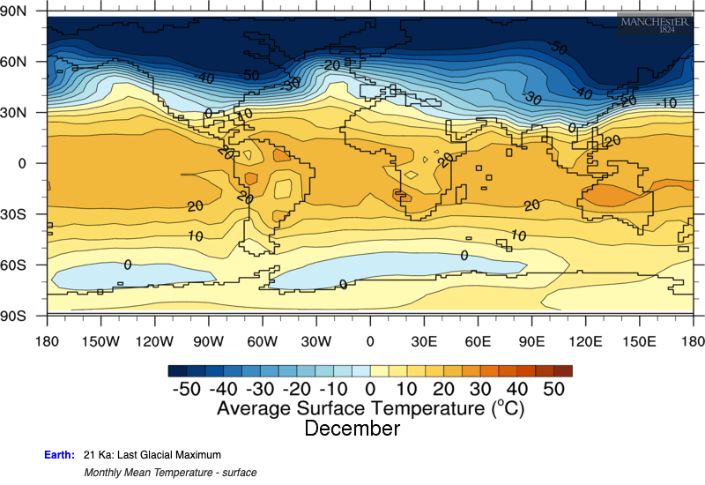
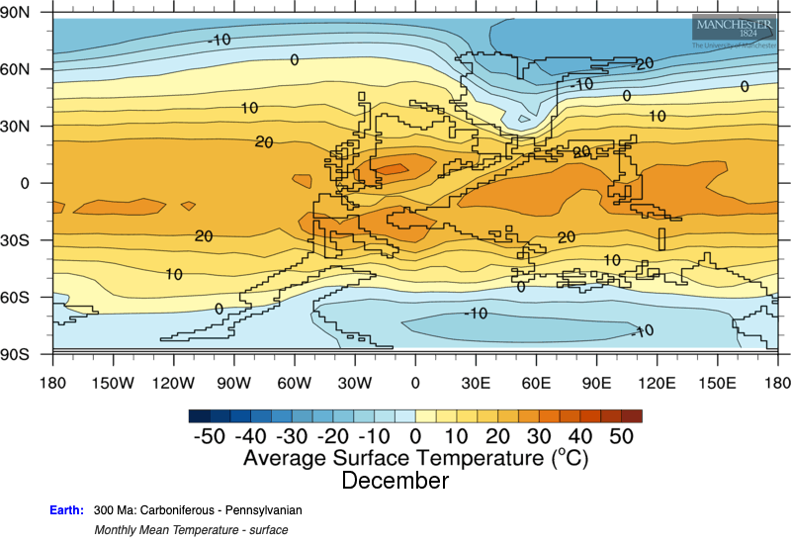
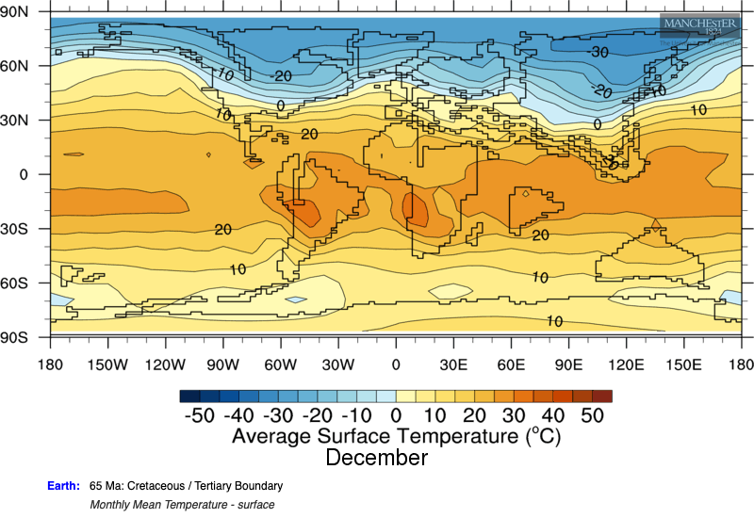
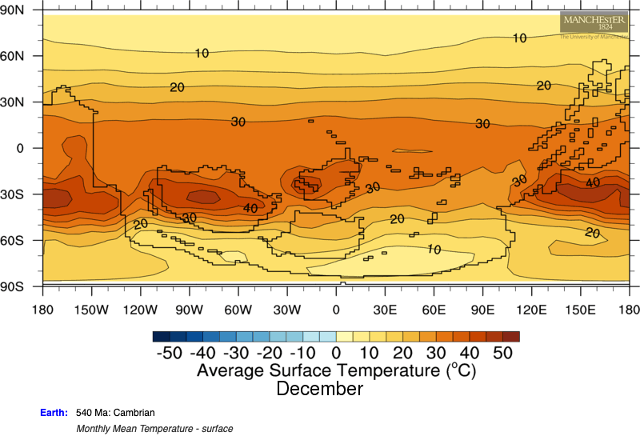
170 Ma
Jura.
2015
20 ka
LGM
300 Ma
Carb.
65 Ma
K–T
540 Ma
Camb.

Slide 48
170 Ma
Jura.
2015
20 ka
LGM
300 Ma
Carb.
65 Ma
K–T
540 Ma
Camb.

Slide 49

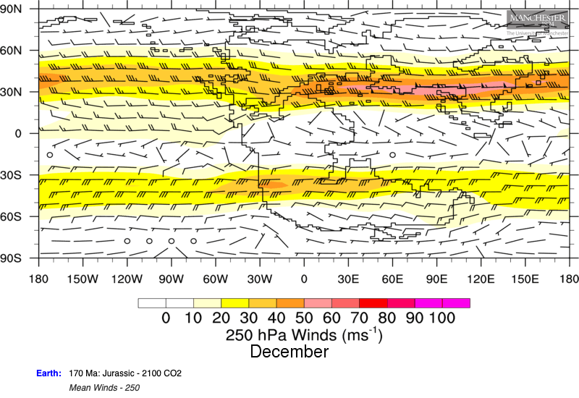
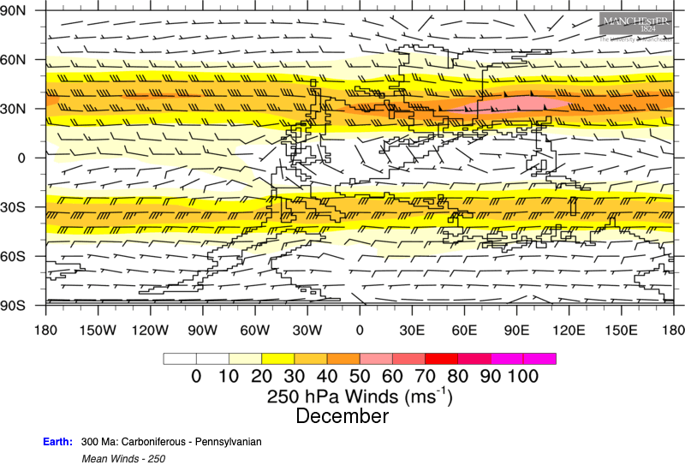
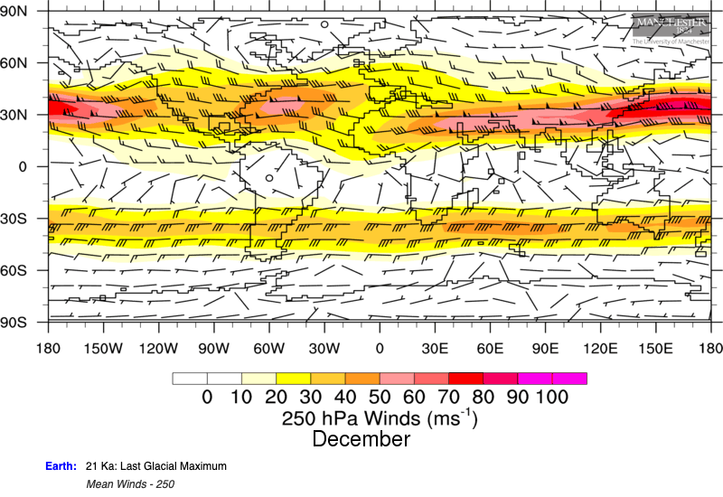
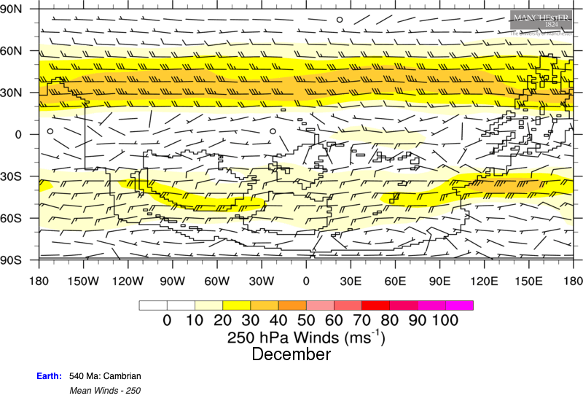

170 Ma
Jura.
2015
20 ka
LGM
300 Ma
Carb.
65 Ma
K–T
540 Ma
Camb.

Slide 50






170 Ma
Jura.
2015
20 ka
LGM
300 Ma
Carb.
65 Ma
K–T
540 Ma
Camb.

Slide 51
Although the Earth has undergone large changes over geologic time, the patterns of moist tropics and dry subtropics with polar jet streams are relatively consistent.
Details about these features change and their locations may shift slightly on the planet, but the planetary-scale circulation (Hadley cells, polar jet streams) is a consistent feature throughout geologic time.

Slide 52
Reading Around the Topic
How Do Climate Models Work? (CarbonBrief.org)

Slide 53
Thought-Provoking Question
Consider a hypothetical distribution of land, oceans, and mountains on the Earth. Map out the associated climate patterns (winds, temperature, precipitation), ocean circulation (currents, temperature, salinity), vegetation, sedimentary record, etc. Justify your map.

Slide 54

FINAL EXAM

Slide 55
On your computer’s or phone’s web browser, go to
kahoot.it
You can download the kahoot app or bookmark the website for future lectures.

Slide 56
ILOs
Describe the composition and components of the cryosphere on Earth.
Identify the periods of extensive glaciation in geological time and know their causes.
Explain how the Earth enters and leaves a Snowball Earth episode.
Discuss the reasons for Arctic amplification.
Describe how climate models work, what the required inputs are, and what the simulated quantities are.
Be able to discuss how to use climate models for research.
Describe what the geological record tells us about present and future climate.

